Slide 1
Java Nested Classes(Inner Classes )

Slide 2
Intro.
nested class is a class that is declared inside the class or interface.
We use inner classes to logically group classes and interfaces in one place to be more readable and maintainable.
It can access all the members of the outer class, including private data members and methods.

Slide 3
Syntax of Inner class
class Java_Outer_class{
//code
class Java_Inner_class{
//code
}
}

Slide 4
Advantage of Java inner classes
Nested classes represent a particular type of relationship that is it can access all the members (data members and methods) of the outer class, including private.
Nested classes are used to develop more readable and maintainable code because it logically group classes and interfaces in one place only.
Code Optimization: It requires less code to write.

Slide 5
Need
users need to program a class in such a way so that no other class can access it

Slide 6
Difference between nested class and inner class in Java
An inner class is a part of a nested class.
Non-static nested classes are known as inner classes.

Slide 7
Types of Nested classes
Non-static nested class (inner class)
Member inner class
Anonymous inner class
Local inner class
Static nested class

Slide 8
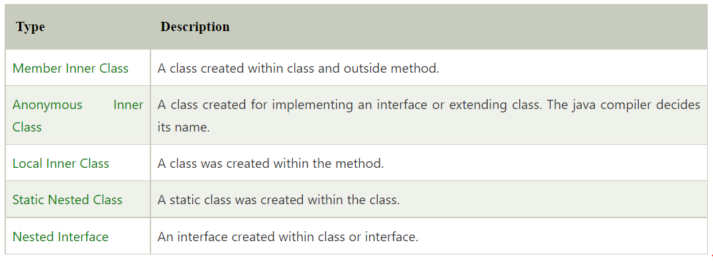

Slide 9
Member Inner class
A non-static class that is created inside a class.
But outside a method.
It is also known as a regular inner class.
It can be declared with access modifiers like public, default, private, and protected.

Slide 10
Syntax
class Outer{
//code
class Inner{
//code
}
}

Slide 11
Example
class Outer{
private int data=30;
class Inner{
void msg(){ System.out.println("data is "+data); }
}
public static void main(String args[]){
Outer obj=new Outer();
Outer.Inner in=obj.new Inner();
in.msg();
} }

Slide 12
Internal code
An object or instance of a member's inner class always exists within an object of its outer class.
The new operator is used to create the object of member inner class with slightly different syntax.
SYNTAX: OuterClassRef.new InnerClassConstructor();
Example: obj.new Inner();

Slide 13
Internal code
The java compiler creates two class files in the case of the inner class.
The Java compiler creates a class file named Outer$Inner in this case.
We must have to create the instance of the outer class.
The inner class has the reference of Outer class that is why it can access all the data members of Outer class including private

Slide 14
Internal code Example
import java.io.PrintStream;
class Outer$Inner
{
final Outer this$0;
Outer$Inner()
{ super();
this$0 = Outer.this;
}
void msg()
{
System.out.println((new StringBuilder()).append("data is ")
.append(Outer.access$000(Outer.this)).toString());
}
}

Slide 15
Anonymous inner class
Java anonymous inner class is an inner class without a name.
And for which only a single object is created.
An anonymous inner class can be useful when making an instance of an object with certain "extras" such as overloading methods of a class or interface, without having to actually subclass a class.
A class that has no name is known as an anonymous inner class in Java.

Slide 16
It should be used if you have to override a method of class or interface. Java Anonymous inner class can be created in two ways:
Class (may be abstract or concrete).
Interface.

Slide 17
Example
abstract class Person{
abstract void eat();
}
class Test {
public static void main(String args[]){
Person p=new Person(){
void eat(){System.out.println("nice fruits");}
};
p.eat();
}
}

Slide 18
A class is created, but its name is decided by the compiler, which extends the Person class and provides the implementation of the eat() method.
An object of the Anonymous class is created that is referred to by 'p,' a reference variable of Person type.

Slide 19
Internal Code
import java.io.PrintStream;
static class Test$1 extends Person
{
TestAnonymousInner$1(){}
void eat()
{
System.out.println("nice fruits");
}
}

Slide 20
Using an interface
interface Eatable{
void eat();
}
class Test1{
public static void main(String args[]){
Eatable e=new Eatable(){
public void eat(){System.out.println("nice fruits");}
};
e.eat();
}
}

Slide 21
Local inner class
A class i.e., created inside a method, is called local inner class in java.
Created inside a block.
Sometimes this block can be a for loop, or an if clause.
Local Inner classes are not a member of any enclosing classes.
Local inner classes cannot have any access modifiers associated with them.
They can be marked as final or abstract.
These classes have access to the fields of the class enclosing it.

Slide 22
example
public class local_o {
private int data=30;
void display(){
class Local{
void msg(){System.out.println(data);}
}
Local l=new Local();
l.msg();
}
public static void main(String args[]){
local_o obj=new local_o();
obj.display();
}
}

Slide 23
Internal code
import java.io.PrintStream;
class local_o$Local
{
final local_o this$0;
local_o$Local()
{
super();
this$0 = Simple.this;
}
void msg()
{
System.out.println(localInner1.access$000(local_o.this));
}
}

Slide 24
Rules for Java Local Inner class
Local inner class cannot be invoked from outside the method.

Slide 25
example
class localInner2{
private int data=30;//instance variable
void display(){
int value=50;//local variable must be final till jdk 1.7 only
class Local{
void msg(){System.out.println(value);}
}
Local l=new Local();
l.msg();
}
public static void main(String args[]){
localInner2 obj=new localInner2();
obj.display();
}
}

Slide 26
static nested class
A static class is a class that is created inside a class, is called a static nested class in Java.
It cannot access non-static data members and methods.
It can be accessed by outer class name.
It can access static data members of the outer class, including private.
The static nested class cannot access non-static (instance) data members or

Slide 27
Example
class Outer{
static int data=30;
static class Inner{
void msg(){System.out.println("data is "+data);}
}
public static void main(String args[]){
Outer.Inner obj=new Outer.Inner();
obj.msg();
}
}

Slide 28
Internal code
import java.io.PrintStream;
static class TestOuter1$Inner
{
TestOuter1$Inner(){}
void msg(){
System.out.println((new StringBuilder()).append("data is ")
.append(TestOuter1.data).toString());
}
}

Slide 29
Example
public class Outer2{
static int data=30;
static class Inner{
static void msg(){System.out.println("data is "+data);}
}
public static void main(String args[]){
Outer2.Inner.msg();
//no need to create the instance of static nested class
}
}

